Slide 1
Material Science MATS201 Module III

Slide 2
Phase diagrams
Phase diagrams are graphical representations of the phases present in an alloy under various temperature, pressure, and chemical composition conditions.
The solidification of metal alloys is clearly understood by means of equilibrium diagrams.
These are graphic representations of changes in state due to variations in temperature and concentration.

Slide 3
Iron Carbon Equilibrium Diagram
Carbon is the most important alloying element in iron which significantly affects the allotropy, structure and properties of iron.
The study of Fe-C system is thus, important, more so as it forms the basis of commercial steels and cast irons, and many of the basic features of this system influence the behaviour of even the most complex alloy steels.

Slide 4
Steels may have incidental elements, or intentionally added alloying elements, which modify this diagram, but if modifications are interpreted cautiously, then this diagram acts as a guide.
The ability to interpret this diagram is important for proper appreciation of phase changes. Fe-C diagram actually provides a valuable foundation on which to build knowledge of large variety of both plain carbon and alloy steels.

Slide 5
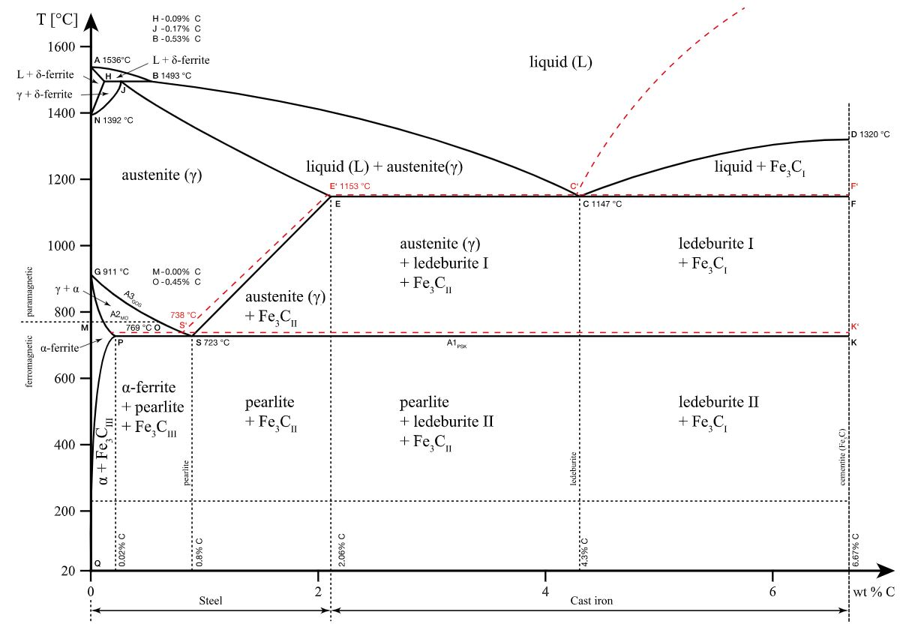
Conventionally, the complete Fe-C diagram should extend from 100% Fe to 100% carbon, but it is normally studied up to around 6.67% carbon as iron alloys of practical industrial importance contain no more than 5% carbon.

Slide 6
Ferrous Materials
The term ferrous comes from the Latin word ferrum, which means "iron-containing metal compound."
Ferrous metals are those that contain only small amounts of iron in their composition.
Ferrous metals are magnetic and have a high strength and hardness due to the iron content.

Slide 7
Their properties, on the other hand, can vary greatly depending on the variety of alloying elements that make them up.
A ferrous metal is known for its hardness, durability and tensile strength.
Due to their high carbon content, ferrous metals are susceptible to corrosion when exposed to moisture.

Slide 8
Due to their vulnerability to corrosion, they tend to be mixed with a lot of different alloying elements in order to get the desired properties.
Some examples of alloying elements used include chromium, vanadium, nickel and manganese.
These elements can give ferrous steels the material properties that make them widely used in various engineering industries.

Slide 9
Alloy steel
An alloy steel is a type of steel alloyed with more than one element (alloying elements) and these are added to increase strength, hardness, wear resistance and toughness.
The added alloying elements that are added to the base iron and carbon structure typically total no more than 5% of the alloy steel’s material composition.

Slide 10
A high alloy steel has alloying elements (not including carbon or iron) that make up more than 8% of its composition.
These alloys are less common, because most steel only dedicates a few percent to the additional elements.
Stainless steel is the most popular high alloy, with at least 10.5% chromium by mass.
This ratio gives stainless steel more corrosion resistance, with a coating of chromium oxide to slow down rusting.

Slide 11
Meanwhile, low alloy steel is only modified slightly with other elements, which provide subtle advantages in hardenability, strength, and free-machining.
By lowering the carbon content to around 0.2%, the low alloy steel will retain its strength and boast improved formability.

Slide 12
Common Steel Alloying Elements
When it comes to steel, there are many different elements that can be added to the base material, allowing the purchaser to tweak variances until the right alloy is found.
Manganese: Used in tandem with small amounts of sulfur and phosphorus, the steel alloy becomes less brittle and easier to hammer.
Chromium: A small percentage (0.5% - 2%) can help to harden the alloy; larger percentages (4% - 18%) have the added effect of preventing corrosion.

Slide 13
Vanadium: With only .15%, this element can boost strength, heat resistance, and overall grain structure. Mixed together with chromium, the steel alloy becomes much harder, but still retains its formability.
Nickel: Up to 5%, this alloying element will improve the steel’s strength. In excess of 12%, it provides impressive corrosion resistance.
Tungsten: Boosts heat resistance, so the melting point is higher. Also improves the structural makeup of the steel.

Slide 14
Carbon steel
Carbon steel is a common type of steel that is an alloy of iron and carbon.
It has a higher carbon content, lower melting point and greater durability compared to stainless steel.
Carbon steel is the most widely used engineering and construction material for industrial applications on a large scale, including marine structures, power plants, transportation, chemical processing and petroleum production and refining.
Carbon steel has high tensile strength and hardness but is significantly more prone to corrosion.

Slide 15
Carbon steel may contain a range of carbon concentrations from 0.01% to 1.5% in a given alloy.
This variation results in different types of carbon steel:
(i) Low carbon or mild steel
(ii) Medium carbon steel
(iii) High carbon steel

Slide 16
(i). Low carbon or mild steel:
0.25% carbon concentration
Low carbon steels are often used in automobile body components, structural shapes (I-beams, channel and angle iron), pipes, construction and bridge components, and food cans.

Slide 17
(ii). Medium carbon steel:
0.25% to 0.70% carbon concentration
As a result of their high strength, resistance to wear and toughness, medium-carbon steels are often used for railway tracks, train wheels, crankshafts, and gears and machinery parts requiring this combination of properties.
(

Slide 18
(iii) High carbon steel:
0.7% to 1.5% carbon concentration
Due to their high wear-resistance and hardness, high-carbon steels are used in cutting tools, springs high strength wire and dies.

Slide 19
Cast iron
Cast iron is one of the group of carbon-iron alloys that can easily be molten and poured (casted) into any desired shape due to its 2% carbon content.
Cast iron is preferred for manufacturing equipment or materials whose melting point temperature must remain low during their operation.
There are two types of cast iron available for manufacturing purposes:
(i) White Cast Iron
(ii) Grey Cast Iron

Slide 20
(i). White Cast Iron
White cast iron is a type of cast iron in which the carbon content is present almost 2% more than a simple alloy in the form of cementite.
For this reason, when white cast iron is fractured, it exhibits a whitish-silver like fracture.
White cast irons are used in abrasion-resistant parts where its brittleness is of minimum concern such as shell liners, slurry pumps, ball mills, lifter bars, extrusion nozzles, cement mixers, pipe fittings, flanges, crushers and pump impellers.

Slide 21
(ii). Grey Cast Iron
Grey cast iron is a type of cast iron in which the carbon content is present almost 2% more than a simple alloy in the form of a graphitic microstructure.
Due to the presence of graphite, it is relatively inexpensive, durable and easily malleable.
It is used in applications where its high stiffness, machinability, vibration dampening, high heat capacity and high thermal conductivity are of advantage, such as internal combustion engine cylinder blocks, flywheels, gearbox cases, manifolds, disk brake rotors and cookware.

Slide 22
Wrought iron
Wrought iron is a type of iron that is tough, malleable, corrosion-resistant and ductile. "Wrought" means "worked," so the term literally means "worked iron."
In ancient times, wrought iron was produced by hammering a metal repeatedly.
Wrought iron is now mostly manufactured from cast iron in an indirect coal fired furnace.
Wrought iron contains siliceous slag, which gives this metal its unique properties.

Slide 23
Wrought iron is nearly carbon free and has a fibrous structure that allows it to be readily forged and welded.
It also contains no or low carbon, which helps make it resistant to corrosion. Cast iron typically contains 2-4% carbon.
The fibrous texture in wrought iron makes it highly ductile, allowing it to withstand in high tension and compression.
Wrought iron becomes stronger the more it's worked.

Slide 24
Wrought iron is mainly used for ornamental purposes.
It is often used to make metal gates, iron railings, garden furniture, driveway gates and other decorative ironwork for outdoor display.
Decorative items such as bedsteads, candle holders, curtain rods and wine racks are still sometimes made from wrought iron. It is also used in conservation work to preserve or replace older wrought iron work.

Slide 25
Heat Treatment
Heat treatment is defined as an operation involving the heating and cooling of a metal or an alloy in the solid-state to obtain certain desirable properties without change composition.
The process of heat treatment is carried out to change the grain size, to modify the structure of the material, and to relieve the stresses set up the material after hot or cold working.

Slide 26
Heat treatment consists of heating the metal near or above its critical temperature, held for a particular time at that finally cooling the metal in some medium which may be air, water, brine, or molten salts.
The heat treatment process includes annealing, tempering, normalizing and quenching, case hardening, nitriding, cyaniding, etc.

Slide 27
Annealing
Annealing is a heat treatment process that changes the physical and sometimes also the chemical properties of a material to increase ductility and reduce the hardness to make it more workable.
An annealing furnace works by heating a material above the recrystallization temperature and then cooling the material once it has been held at the desired temperature for a suitable length of time.

Slide 28
When heated during the specific process of annealing, atoms migrate in their crystal lattice and the number of atom dislocations goes down, leading to changes in both ductility and hardness.
As the material cools it crystallizes again.
Annealing works in three stages –
the recovery stage,
the recrystallization stage and
the grain growth stage.

Slide 29
Recovery Stage
This stage is where the furnace or other heating device is used to raise the temperature of the material to such a point that the internal stresses are relieved.
Recrystallization Stage
Heating the material above its recrystallization temperature but below its melting point causes new grains to form without any residual stresses.
Grain Growth Stage
Cooling the material at a specific rate causes new grains to develop. After which the material will be more workable. Subsequent operations to alter mechanical properties can be carried out following annealing.

Slide 30
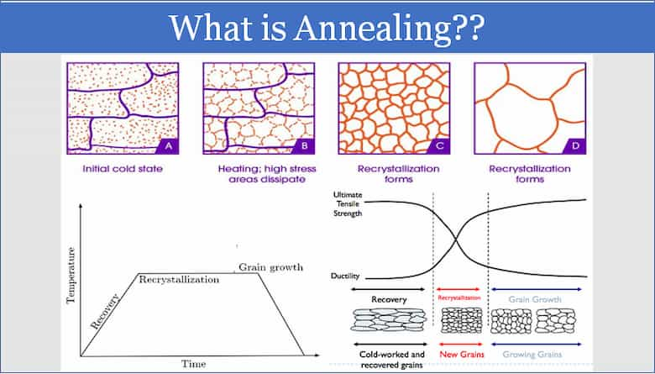

Slide 31
Normalizing
Normalizing is a heat treatment process that is used to make a metal more ductile and tough after it has been subjected to thermal or mechanical hardening processes.
Normalizing involves heating a material to an elevated temperature and then allowing it to cool back to room temperature by exposing it to room temperature air after it is heated.
This heating and slow cooling alters the microstructure of the metal which in turn reduces its hardness and increases its ductility.

Slide 32
Normalizing is often performed because another process has intentionally or unintentionally decreased ductility and increased hardness.
Normalizing is used because it causes microstructures to reform into more ductile structures.
This is important because it makes the metal more formable, more machinable, and reduces residual stresses in the material that could lead to unexpected failure.

Slide 33
Difference between Annealing and Normalizing
Normalizing is very similar to annealing as both involve heating a metal to or above its recrystallization temperature and allowing it to cool slowly in order to create a microstructure that is relatively ductile.
The main difference between annealing and normalizing is that annealing allows the material to cool at a controlled rate in a furnace.

Slide 34
This difference means normalizing has a faster cooler rate than annealing.
The faster cooler rate can cause a material to have slightly less ductility and slightly higher hardness value than if the material had been annealed.
Normalizing is also generally less expensive than annealing because it does not require additional furnace time during the cool down process.

Slide 35
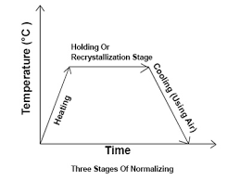
There are three main stages to a normalizing process.
Recovery Stage
Recrystallization Stage
Grain Growth Stage

Slide 36
Recovery Stage
During the recovery stage, a furnace or other type of heating device is used to raise the material to a temperature where its internal stresses are relieved.
Recrystallization Stage
During the recrystallization stage, the material is heated above its recrystallization temperature, but below its melting temperature. This causes new grains without preexisting stresses to form.

Slide 37
Grain Growth Stage
During the grain growth, the new grains fully develop.
This growth is controlled by allowing the material to cool to room temperature via contact with air.
The result of completing these three stages is a material with more ductility and reduced hardness.
Subsequent operations that can further alter mechanical properties are sometimes carried out after the normalizing process.

Slide 38
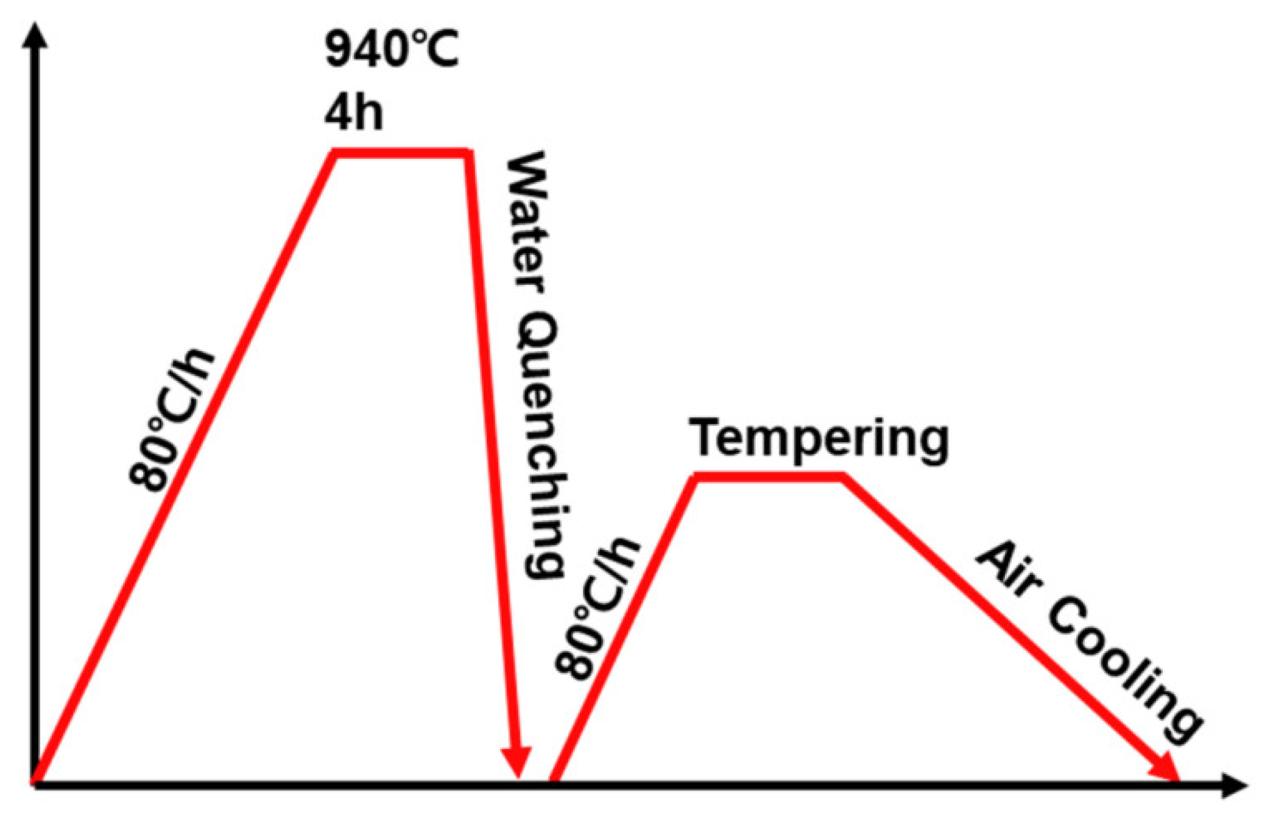
Quenching
Quenching is a type of metal heat treatment process.
Quenching involves the rapid cooling of a metal to adjust the mechanical properties of its original state.

Slide 39
To perform the quenching process, a metal is heated to a temperature greater than that of normal conditions, typically somewhere above its recrystallization temperature but below its melting temperature.
The metal may be held at this temperature for a set time in order for the heat to “soak” the material.

Slide 40
Once the metal has been held at the desired temperature, it is quenched in a medium until it returns to room temperature.
The metal also may be quenched for an extended period of time so that the coolness from the quenching process is distributed throughout the thickness of the material.

Slide 41
Quenching Media
There are a variety of quenching media available that can perform the quenching process. Each media has its own unique quenching properties.
Considerations for the type of media use include quenching speed, quenching media environmental concerns, quenching media replacement, and quenching media cost.
Here are the main types of quenching media:
Air
Oil
Water
Brine

Slide 42
Air
Air is a popular quenching media used to cool metals for quenching due to affordability.
In fact, any material that is heated and then allowed to cool to room temperature simply by being left alone is considered to have been air quenched.
Air quenching is also more intentionally performed when it is compressed and forced around the metal being quenched.
This cools the part more rapidly than still air, although even compressed air may still cool many metals too slowly to alter the mechanical properties.

Slide 43
Oil
Oil is able to quench heated metals much more rapidly than compressed air.
To quench with oil, a heated part is lowered into a tank that is filled with some type of oil.
The oil can also be flushed through the part.
Different types of oil are often used depending on the application because of their varying cooling rates and flash points.

Slide 44
Water
Water is able to quench heated metals rapidly as well. It can cool a metal even faster than oil.
In a fashion similar to oil quenching, a tank is filled with water and the heated metal is submerged in it.
It can also be flushed through a part.
One benefit of water is that flammability of the media is not a concern.

Slide 45
Brine
Brine is a mixture of water and salt.
Brine cools faster than air, water, and oil.
The reason for this is that the salt and water mixture discourages the formation of air globules when it is placed in contact with a heated metal.
This means that more of the surface area of the metal will be covered with the liquid, as opposed to air bubbles.

Slide 46
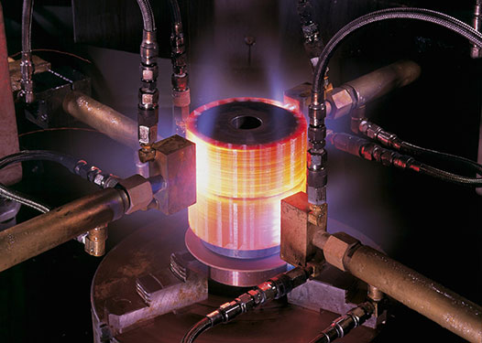
Tempering
Tempering is a process whereby a metal is precisely heated to below the critical temperature, often in air, a vacuum, or inert atmospheres.

Slide 47
The exact temperature varies according to the amount of hardness that needs to be reduced.
High temperatures will reduce hardness and increase elasticity and plasticity but can cause a reduction in yield and tensile strength.
Lower temperatures will maintain much of the hardness but will reduce brittleness.

Slide 48
Tempering can be divided into three main groups:
Low temperature (160-300°C): used for case hardening components and cold working tool steels. Typically, hardness requirement is around 60 HRC.
Tempering of spring steels (300-500°C): used for spring steels or similar applications. Typically, hardness requirement is around 45 HRC.
High temperature (500°C or higher): used for quenched and tempered steels, hot working tool steels and high speed steel. The hardness will vary from 300HB to 65HRC dependent on the material.

Slide 49
The tempering temperature may vary, depending on the requirements and the steel grade, from 160°C to 500°C or higher.
Tempering is normally performed in furnaces which can be equipped with a protective gas option.
Protective gas will prevent the surface from oxidation during the process and is mainly used for higher temperatures.
For some types of steels the holding time at the tempering temperature is of great importance; an extended holding time will correspond to a higher temperature.

Slide 50
Case Hardening
Case hardening is a technique in which a metal surface is reinforced by the adding of a thin layer of another metal alloy that is more durable, increasing the object's life.
This is particularly significant for the manufacture of machine parts, carbon steel forgings and carbon steel pinions.
Case hardening is also known as surface hardening.

Slide 51
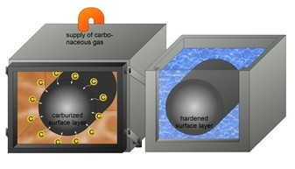
Case hardening is a simple method of hardening steel involving the use of metal that has low carbon content, and combining it with a metal that has a higher carbon content.
The combination of metals produces a product that is much harder.
The addition of the low-carbon metal creates a material that can be molded easily into desired shapes.

Slide 52
Case hardening is usually performed after the formation of the component into its final form.
Components that are subjected to severe impacts and high pressures are generally case hardened.
Case hardening is suitable both for carbon and alloy steels, and typically mild steels are used.
Case hardened steel is formed by diffusing
carbon (carburization),
nitrogen (nitriding) and/or
boron (boriding)
into the outer layer of the steel at high temperature, and then heat treating the surface layer to the desired hardness.

Slide 53
The surface improvement not only increases the product strength, but also assists in avoiding weakening of the iron.
One advantage of this method of hardening steel is that the inner core is left untouched, and therefore still processes properties such as flexibility and relative softness.
Parts that are subject to high pressures and sharp impacts are commonly case hardened.

Slide 54
Case hardening steels are particularly suitable for:
Screws
Fasteners
Firing pins
Rifle bolts
Engine camshafts
Because hardened metal is usually more brittle than softer metal, it is not always a suitable choice for applications where the metal part is subject to certain kinds of stress.
In such applications, case hardening can provide a part that does not fracture, but also provides adequate wear resistance on the surface.

Slide 55
Non-Ferrous metals and alloys
The difference between ferrous and non-ferrous metals is that ferrous metals contain iron making most of their metals magnetic in nature.
There are a large number of non-ferrous materials, covering every metal and alloy that does not contain iron.
Non-ferrous metals are usually obtained from minerals like carbonates, silicates and sulphides before being refined through electrolysis.

Slide 56
Non-ferrous metals include aluminium, copper, lead, nickel, tin, titanium and zinc, as well as copper alloys like brass and bronze.
Other rare or precious non-ferrous metals include gold, silver and platinum, cobalt, mercury, tungsten, beryllium, bismuth, cerium, cadmium, niobium, indium, gallium, germanium, lithium, selenium, tantalum, tellurium, vanadium, and zirconium.

Slide 57
Precious metals and their alloys are rare metallic elements and alloys such as silver, gold, platinum, palladium, iridium, osmium, rhodium, and ruthenium.
They tend to be costly and in high demand due to their special properties including conductivity and resistance to corrosion.

Slide 58
Aluminum and its alloys are lightweight metals with good corrosion resistance, ductility, and strength.
Aluminum is renowned for its low density and is the most widely used non-ferrous metal.
Relatively pure aluminum is used only when corrosion resistance is more important than strength or hardness.

Slide 59
Copper is a reddish orange, soft, and malleable (low hardness) metal that is a good conductor of heat and electricity.
Brass is an alloy of copper and zinc; the proportions of zinc and copper can be varied to create a range of brasses with varying properties.
Bronze is an alloy of copper and (usually) tin that is much harder and more brittle than brass.

Slide 60
Zinc and its alloys are metals that are used widely in the production of die cast components.
Zinc-based alloys are used for casting and wrought applications Pure or unalloyed zinc is used in non-structural applications and to galvanize metals such as iron in order to prevent corrosion.
It is also used in batteries and as an alloy with copper to make brass.

Slide 61
Nickel and its alloys are metals with high strength and toughness, excellent corrosion resistance, and superior elevated temperature properties.
They are able to withstand an assortment of extreme operating conditions involving environments that are corrosive, high temperature, high stress, and combinations of these factors.
Other nonferrous materials used in their pure form and in alloys include beryllium, cobalt, hafnium, lead, magnesium, molybdenum, tantalum, titanium, tungsten, and zirconium.

Slide 62
End of Module III Thank You

